Slide 1

Project #3
BILLBOARD TOP CHARTS
TEAM MEMBERS:
ALEX LI
JEANIE WU
MARK WERDEN
ROBERT HARVEY

Slide 2
PROJECT DESCRIPTION
Our goal was to determine which musical artists had the most Top Billboard Chart hits for the years 2014 – 2021, using various data analysis methods such as Postgres, JavaScript, Plotly, APIs, JSON, and more. The end-product is a dashboard that can be used to filter and visually display data in an easy-to-use, interactive, and intuitive way. Dashboard users can find data using dropdown menus to sort and filter by both year and artist. The data displayed is dynamic and moves with the user, creating a fun experience.

Slide 3
Data source
Our Billboard API returned data that could be filtered by artist, number of occurrences on the Billboard charts, song title, and most importantly, ranking. Using this data, we were able to display which artist had the greatest number of weeks on the Top Billboard Charts, the top artist for each year (selected by using the dropdown), and which artists had the greatest number of Billboard Top Charts songs during the dataset (2014-2021).

Slide 4
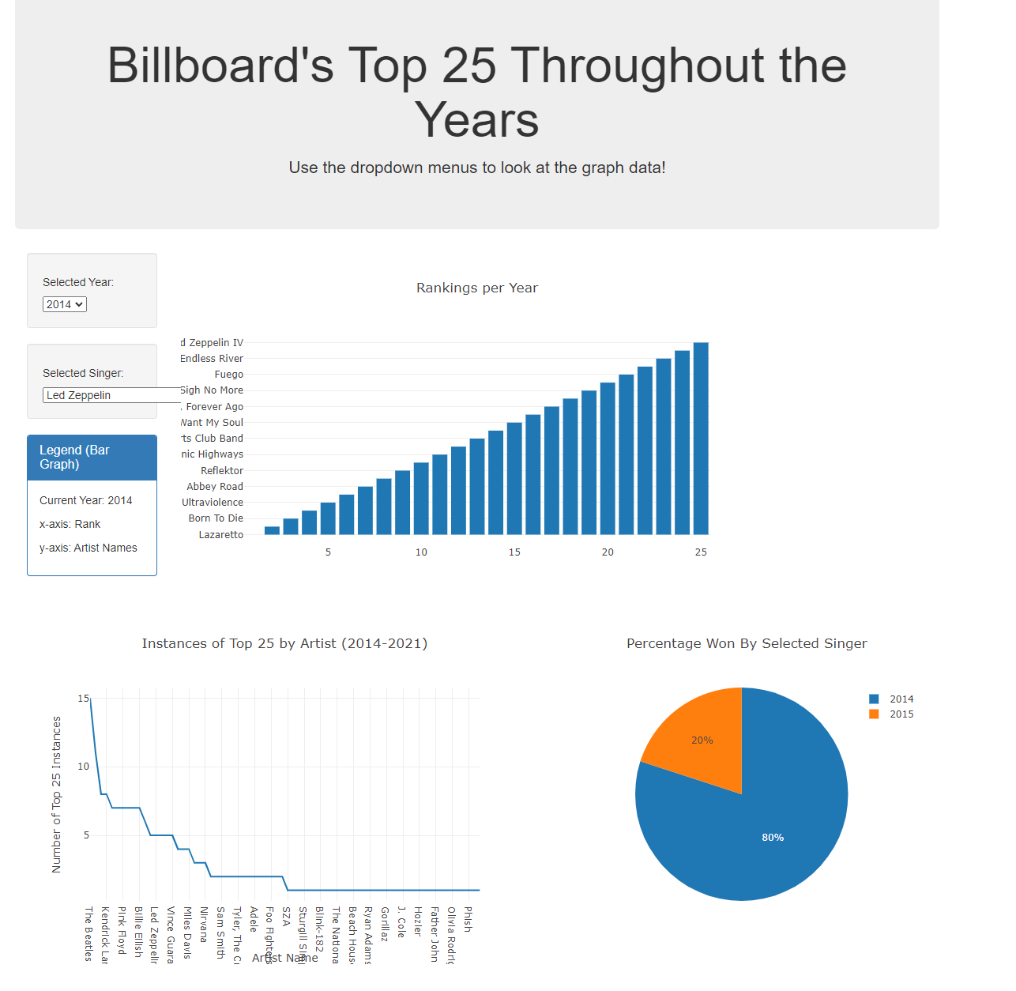
dashboard

Slide 5
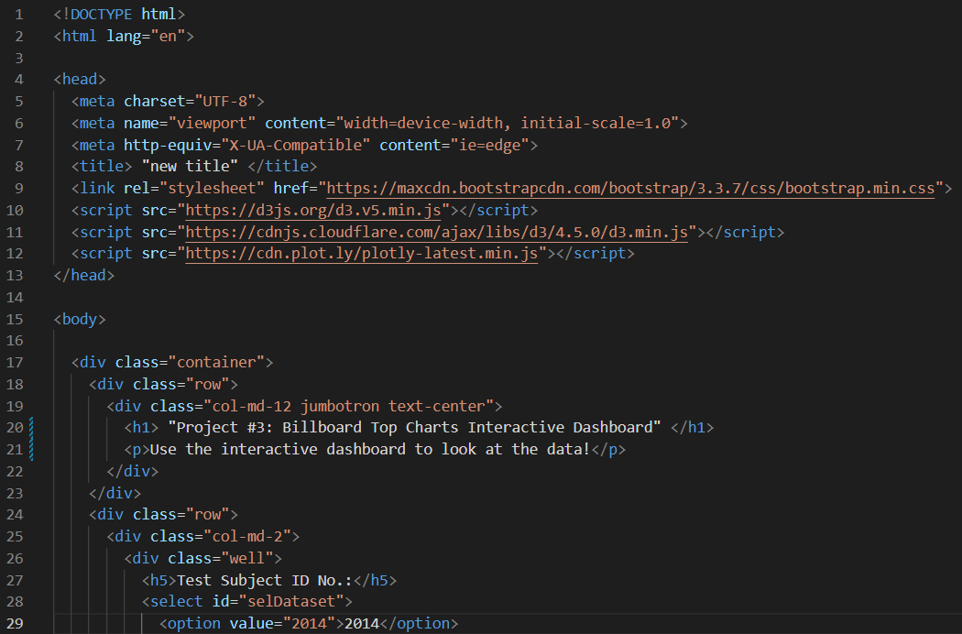
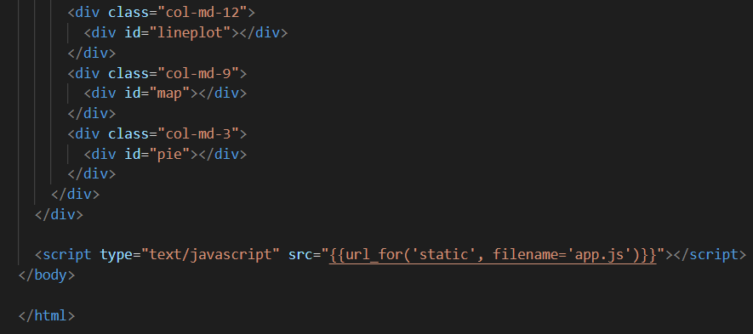
Index.html
Image #1: shows the beginning of the html script, including loading charset and src (d3), headers of various sizes, containers, and formatting
Image #2: shows the end of the html script, which shows a line plot, map, and pie chart

Slide 6
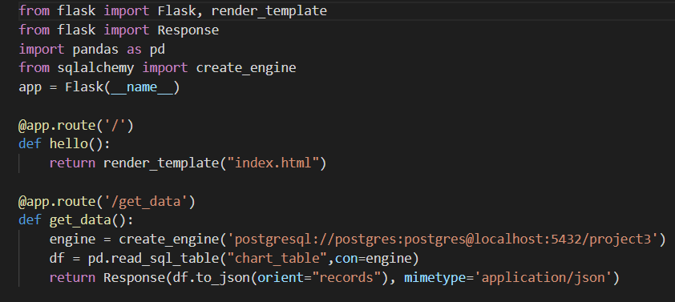
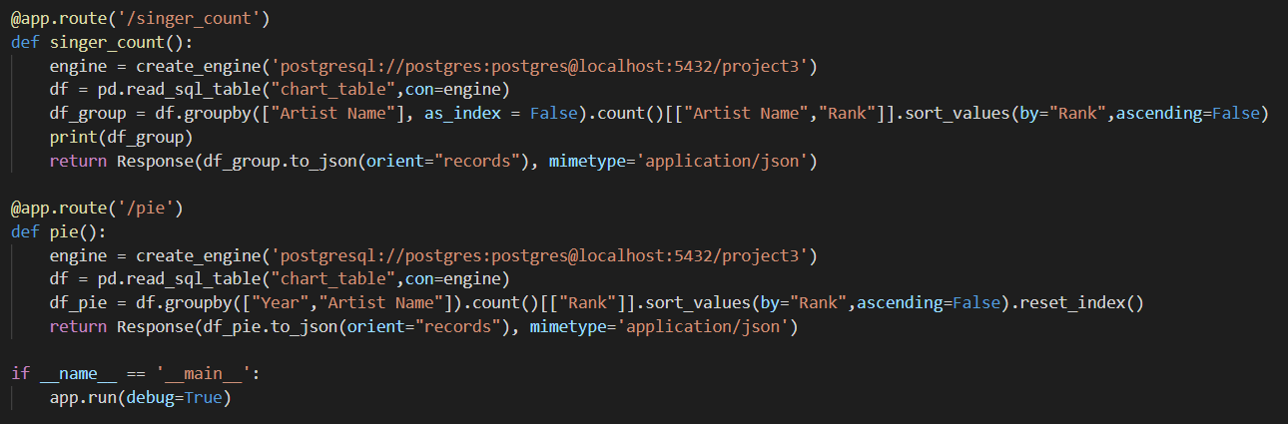
App.py
Image #1: shows the flask app, app route, def, return, creating engines, and creating dataframes reading sql database tables
Image #2: shows app route, def, return, creating engines, groupby, and debug functions

Slide 7
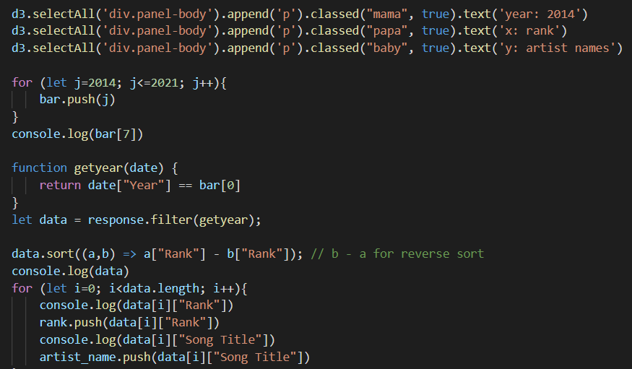
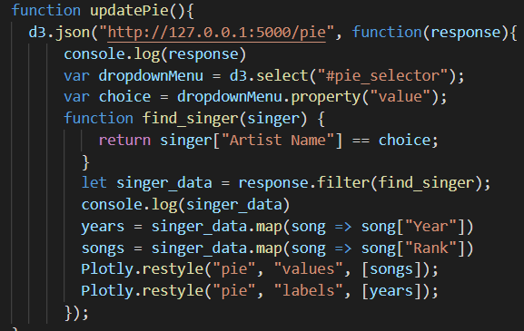
App.js
Image #1: shows the year range for the dataset (2014-2021), filtering by year, and sorting based on rank
Image #2: shows d3.json, creation of dropdown menus, var, functions, returns, let, and Plotly

Slide 8
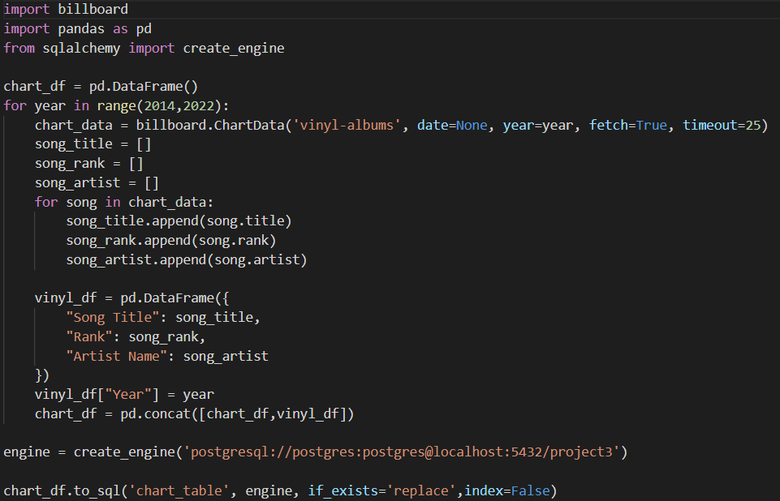
Database.py
The image above shows importing the necessary packages before cleaning the data. Then, a pandas dataframe is created to capture the chart_data, song_title, song_rank, and song_artist as lists. An engine is then created to connect to a postgres database, and the to_sql function is used to conclude the script and connect to postgres

Slide 9
dashboard demonstration

Slide 10
q&a

